Slide 1
Classifying Rocks
Prac

Slide 2
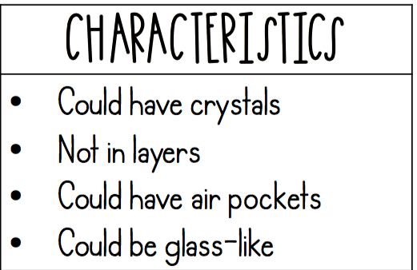
Igneous

Slide 3

Sedimentary

Slide 4

Metamorphic

Slide 5

Classifying Rocks
Directions: Look at each rock. As you look at each rock, pay close attention to its characteristics. These characteristic will help you figure out if it is igneous, sedimentary, or metamorphic. Write the name of the rock in the correct category.

